Slide 1
Strategic Thinking CA3 Semester 2 Capstone Project
Pizza Sales Data Analysis and Prediction
Presented by: Daniela Maftei
Date: 22 May 2025

Slide 2
Strategic Overview & Business Problem
Background: The highly competitive and dynamic nature of the pizza industry. Importance of data-driven decision-making for growth, efficiency, and customer satisfaction.
Business Problem: How can we leverage historical pizza sales data to identify key trends, understand customer behavior, and build predictive models to optimize business operations and sales strategies?
Strategic Importance:
Revenue Growth: Identify peak periods and popular products to maximize sales.
Operational Efficiency: Optimize inventory, staffing, and delivery routes.
Customer Satisfaction: Tailor offerings and promotions based on preferences.
Competitive Advantage: Gain insights to outperform competitors.

Slide 3
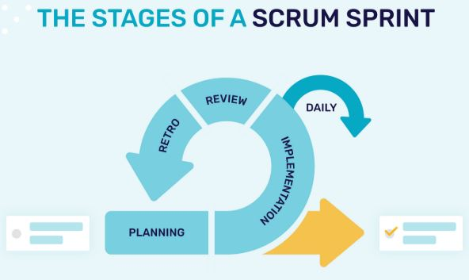
Project Methodology
Project Management Methodology:
Agile (Scrum) Framework: Iterative sprints, daily stand-ups, continuous feedback.
Benefits: Flexibility, rapid iteration, early value delivery, task prioritization, and progress monitoring.
Phases: Business Understanding, Data Understanding, Data Preparation, Modeling, Evaluation and Deployment (Conceptual).

Slide 4
Data Understanding & Initial Observations
Dataset: pizza sales.csv (Source: Kaggle)
Key Attributes: order_details_id, order_id, pizza_id, quantity, order_date, order_time, unit_price, total_price, pizza_size, pizza_category, pizza_ingredients, pizza_name.
Initial Observations:
Dataset contains transactional data for individual pizza items.
No immediate missing values identified (after initial imputation).
Date and time fields require proper parsing for temporal analysis.
Categorical features like pizza_category and pizza_name are key for product analysis.

Slide 5
Data Preparation
Data Cleaning:
Handled missing values (mean imputation for numerical, mode for categorical).
Ensured data consistency across columns.
Data Transformation:
Converted order_date and order_time to appropriate datetime objects.
Created new features: day_of_week, month, and hour from order_date and order_time.
Feature Engineering & Encoding:
One-hot encoded categorical variables (pizza_size, pizza_category, pizza_name, day_of_week) to prepare for machine learning.
Dropped Columns: Removed original identifiers (order_id, pizza_id, order_time, pizza_ingredients) that were not directly used in the final model or were replaced by engineered features.

Slide 6
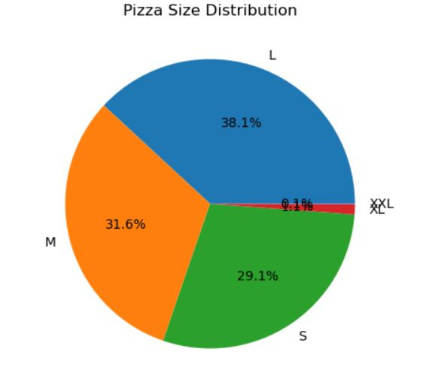
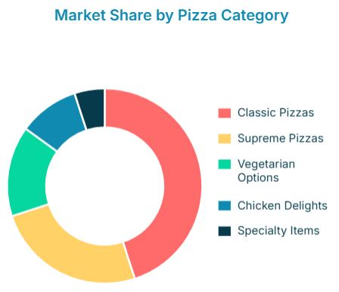
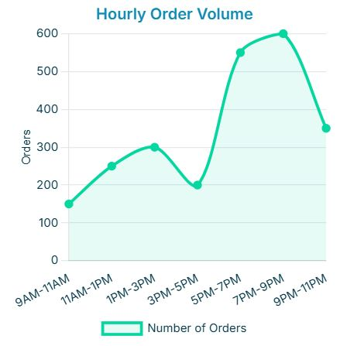
(EDA) Insights
Daily Sales Trend:
Showed significant sales peaks on weekends, indicating higher demand on Friday and Saturday.
Sales by Pizza Category:
'Classic' pizzas consistently dominate sales, followed by 'Supreme' and 'Vegetarian'.
Pizza Size Distribution:
Large and Medium pizzas are the most popular choices, contributing the highest to overall sales volume.
Hourly Sales Trend:
Peak sales observed at lunchtime around 12 PM and evening (5 PM - 8 PM), suggesting dinner rush.

Slide 7
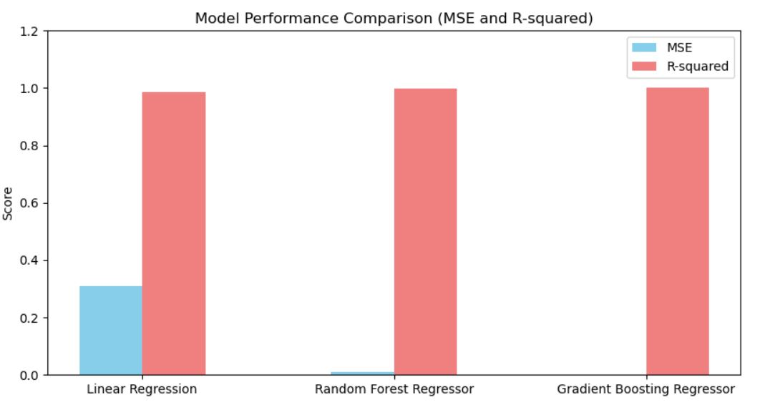
Machine Learning Implementation
Machine Learning Task: Regression – Predicting total_price of pizza orders.
Models Explored:
Linear Regression: Simple, interpretable baseline.
Random Forest Regressor: Ensemble method, robust to outliers, captures non-linearities.
Gradient Boosting Regressor: Powerful ensemble method, often high performance.
Performance Metrics:
Mean Squared Error (MSE): Average squared difference between predicted and actual values (lower is better).
R-squared (R²): Proportion of variance explained by the model (closer to 1 is better).
Initial Model Results (on validation set):
Linear Regression: MSE: 0.31, R²: 0.98
Random Forest Regressor: MSE: 0.01, R²: 1.00
Gradient Boosting Regressor: MSE: 0.00, R²: 1.00

Slide 8
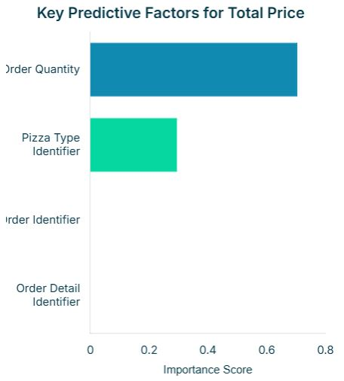
Tuned Model Performance & Feature Importance
Hyperparameter Tuning (Gradient Boosting Regressor):
Used GridSearchCV to optimize model parameters.
Best Hyperparameters:
n_estimators: 200 (Number of boosting stages)
learning_rate: 0.2 (Step size shrinkage)
max_depth: 3 (Maximum depth of individual trees)
Tuned Model Performance (Gradient Boosting Regressor):
MSE: 0.00
R-squared: 1.00
Validation: The tuned model exhibits exceptional predictive power on the test set, indicating strong generalization.
Feature Importance:
quantity (70.48%): By far the most significant predictor of total price.
pizza_id (29.51%): The specific type of pizza is the second most important factor.
order_id, order_details_id: Show negligible importance, as expected for identifiers.

Slide 9
Conclusion & Limitations
Conclusion: This capstone project successfully demonstrated the application of data analysis and machine learning to derive actionable insights from pizza sales data. The Gradient Boosting Regressor achieved excellent predictive performance, highlighting the critical role of quantity and pizza_id in sales.
Project Management Reflection: Agile methodology enabled adaptive development, clear task prioritization, and continuous monitoring, proving effective for this data science initiative.
Limitations:
Data Scope: Lacks customer demographics, marketing spend, weather data, or competitor information.
Overfitting Risk: A perfect R-squared on the test set, while impressive, warrants careful consideration for potential overfitting or data leakage.

Slide 10
Future Improvements
External Data Integration: Incorporate external factors (e.g., local events, holidays, promotions, weather).
Customer Segmentation: Analyze sales patterns by customer groups for personalized marketing strategies.
Advanced Time Series Forecasting: Implement more sophisticated time series models (e.g., ARIMA, Prophet) for more granular future sales prediction.
Deployment: Develop a real-time prediction system for operational use.

